Slide 1
Online Learning Harmful and Ineffective
Gage Farmer

Slide 2
Online learning is not good.
Quite bad, actually.

Slide 3
…but why?
Distance learning is shown to be less effective towards teaching material due to the inherent distractions of the internet
Students not already comfortable with a given program used for the work will be at a disadvantage due to lower quality work and anxiety
Lessons on call are less effective due to lower use of a student’s working memory capacity
Students with ADHD even harmed from this due to greater difficulty of focus as well as increased antisocial behavior from being in isolation instead of in a classroom

Slide 4
Background
1989 – University of Phoenix offered first online institution
1996 – Jones International University became first fully web-based university
2020 – Became the ‘default’ due to the COVID-19 outbreak
From late 2020 to 2021, total undergraduate enrollment dropped by 3.1%, making the total from 2019 to 2021 a drop of 6.6% (1.2 million students) (Saul, 2022)

Slide 5
Useful Terms
Mind Unwandered – Used to describe when a student is focused and not distracted from the topic
Internet Cognitive Fatigue – When a student becomes fatigued due to the distractive nature of the internet
Internet Self-Efficacy – The level of confidence a student has in their own ability to use the internet
Self-Efficacy of Interacting with Learning Content – The level of confidence a student has in their ability to learn through an online course with online materials
Neurodivergence – Refers to people who have certain mental disorders such as ADHD, Autism, Dyslexia, or Dyspraxia

Slide 6
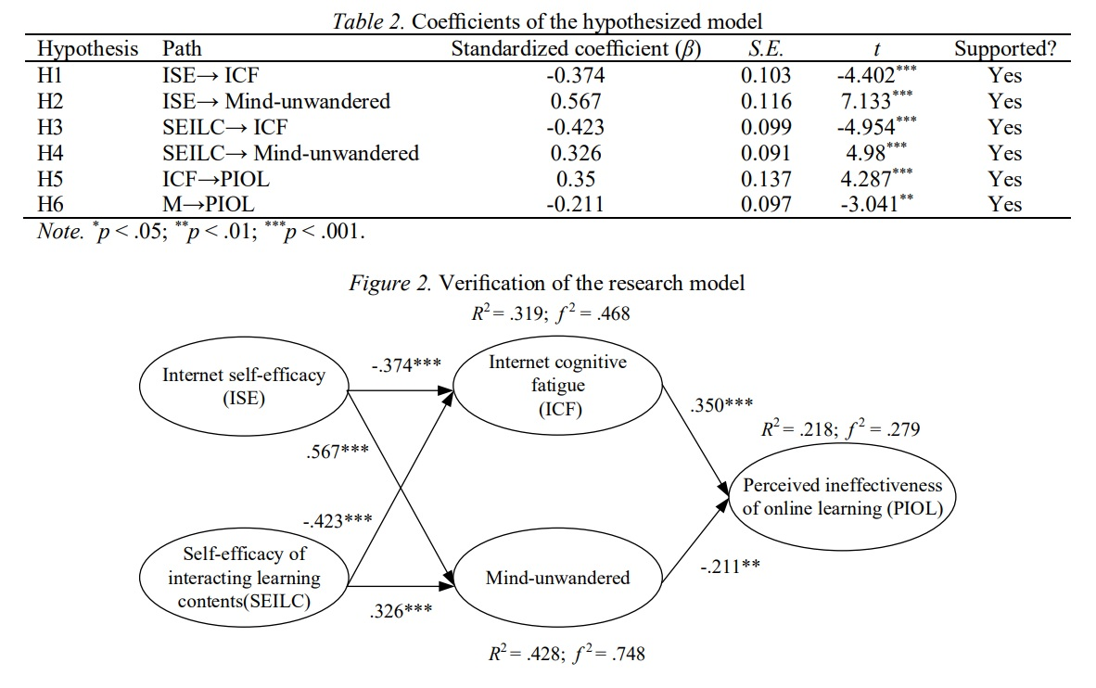
Effectiveness
Student with high internet self-efficacy and low mind unwandered will see more effectiveness in online classes
Very difficult to keep students from becoming distracted and fatigued
Online classrooms lack structure and motive to prevent student from mentally ‘checking out’
Provides less self-fulfillment in completing assignments to a student less comfortable with using the internet
(Hong, 2022)

Slide 7
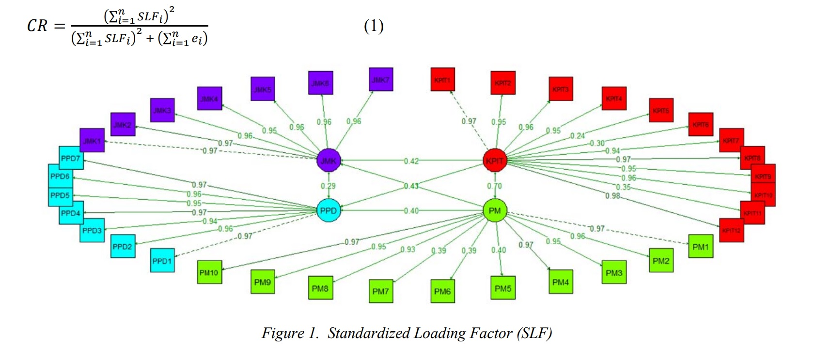
Difficulty
(Ramadhani, 2021)
Students need a high level of working memory in order to retain given information in a lecture
Most do not have this, as it is typically reduced by their lack of focus and self-efficacy
Difficult programs will cause anxiety and insecurity among students in their learning, due to an inability to produce the quality of work they would normally
Many programs need weeks of teaching before actual use in assignments
Ex. Matlab, OrCAD, Excel, Wireshark, or any programming IDE

Slide 8
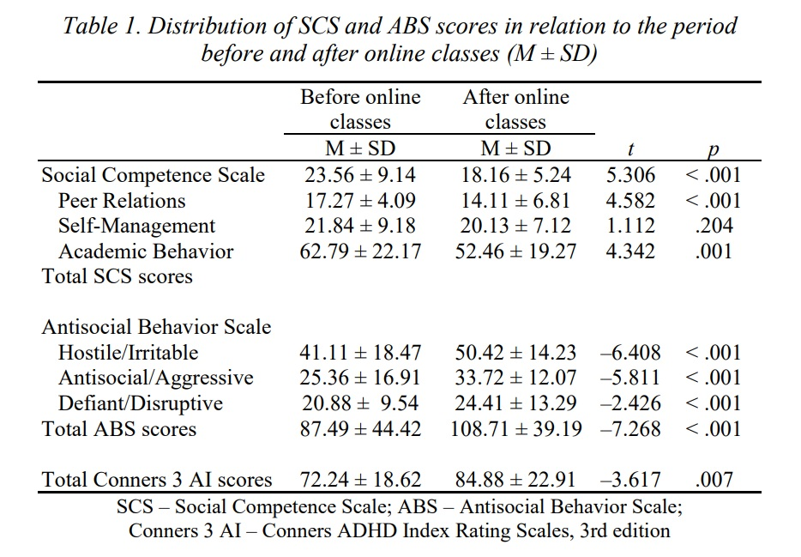
Neurodivergent Students
The group of students effected the most by online learning
Change of setting causes lack of focus due to unstructured environment
No constant reminder of assignments causes students to forget about them entirely
Not being in a classroom with peers encourages antisocial behavior even after lessons were returned to the classroom (Đurić-Zdravković et al., 2021)
Classroom setting is crucial for social development of neurodivergent students, especially when young
(Đurić-Zdravković, 2021)

Slide 9


Counter Argument
Played a major role in slowing the spread of COVID-19
Would have had a longer quarantine
More unnecessary deaths
Does allow an affordable option and a flexible schedule for those working while earning degree

Slide 10
Rebuttal
While it was necessary during a global tragedy, this does not reflect the true nature of distance learning
Insufficient for most students
Somewhat niche use case
Set back the mental and social development of many neurodivergent students

Slide 11
Conclusion
Much more difficult to the average student
Less effective for the amount of time it consumes
Leaves students less satisfied and confident in the education they received
Affects students with ADHD the greatest due to the lack of structure and socialization that goes with being in a classroom with peers

Slide 12
References
Cibrian, F. L., Monteiro, E., Ankrah, E., Beltran, J. A., Tavakoulnia, A., Schuck, S. E. B., Hayes, G. R., & Lakes, K. D. (2021). Parents’ perspectives on a smartwatch intervention for children with ADHD: Rapid deployment and feasibility evaluation of a pilot intervention to support distance learning during COVID-19. PLoS ONE, 16(10), 1–23. https://doi.org/10.1371/journal.pone.0258959
Cortese S., et al (2020). ADHD management during the COVID-19 pandemic: guidance from the European ADHD Guidelines Group. The Lancet Child & Adolescent Health. Volume 4. Issue 6. Pages 412-414. 2352-4642. https://doi.org/10.1016/S2352-4642(20)30110-3
Đurić-Zdravković, A., Japundža-Milisavljević, M., & Roknić, A. (2021). Social competence and antisocial behavior in students with ADHD before beginning and after the end of online classes during COVID-19. TEME: Casopis Za Društvene Nauke, 45(4), 1229–1243. https://doi.org/10.22190/TEME210830073D
Jon-Chao Hong, Xiaohong Liu, Wei Cao, Kai-Hsin Tai, & Li Zhao. (2022). Effects of Self-Efficacy and Online Learning Mind States on Learning Ineffectiveness during the COVID-19 Lockdown. Journal of Educational Technology & Society, 25(1), 142–154.
Nadeau, K. G. (2006). Survival guide for college students with ADHD or Ld. Magination Press.
Ramadhani, R., Sihotang, S. F., Bina, N. S., Rusmini, Harahap, F. S. W., & Fitri, Y. (2021). Undergraduate Students’ Difficulties in Following Distance Learning in Mathematics Based on E-Learning During the COVID-19 Pandemic. TEM Journal, 10(3), 1239–1247. https://doi.org/10.18421/TEM103-30

Slide 13
References
Saul, S. (2022, January 13). U.S. college enrollment dropped again in the fall of 2021, despite the arrival of vaccines. The New York Times. Retrieved April 28, 2022, from https://www.nytimes.com/2022/01/13/us/college-enrollment-2021-omicron.html
Ramsay, J. R. (2020). Rethinking adult ADHD: Helping clients turn intentions into actions. American Psychological Association. https://doi-org.cscc.ohionet.org/10.1037/0000158-000

